Slide 1
mWater Developer - Manual

Slide 2
Outline
Stakeholder information needs
Design
Database
Visualizations
Processes
Annex A – External data sources

Slide 3
HANWASH mWater Database
An information system
for standardized
WASH project monitoring
Scope
Project, activity, and result monitoring
Sector indicator tracking (SIEPA integration)
Implementation tracking
Stakeholders
HANWASH/Rotary (clubs, professional team, board)
Implementing partners (Haiti Outreach, Helvetas, etc.)
DINEPA (ONEPA, OREPA, etc.)
Local authorities (Mayor, CASEC, etc.)
Donors

Slide 4
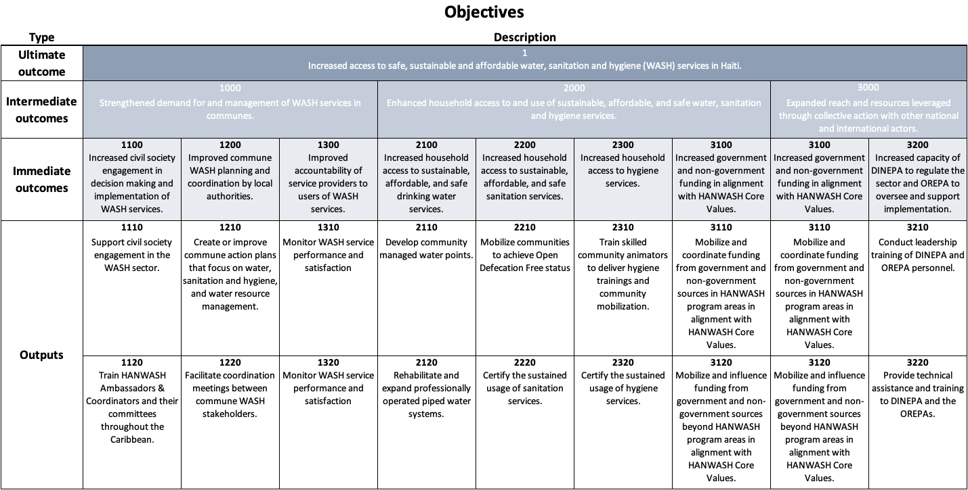
HANWASH Program objectives and expected results

Slide 5
mWater developer
Resources
Implementation monitoring
Results by project - Visualize multiple projects, core data, and their results
Quality assurance – Used to clean up data coming from implementing partners
Microsoft teams
mWater Database – Used to store documentation for system usage
Roles and responsibilities
Modify and create new user-centered data visualizations
Ensure Implementation Monitoring indicators are calculated correctly
Perform quality assurance on implementation data
Create and maintain the documentation of the entire information system
Train and support stakeholders in the system usage

Slide 6
Stakeholder groups
HANWASH professional team (staff)
HANWASH Board of Directors
Local Rotary Clubs (“Champion Clubs”) and HANWASH Ambassadors
Partner Rotary Districts (“Champion Districts”)
DINEPA
Local authorities (mayors, ASECs, CASECs)
Implementing partners
Funders
M&E Officer
mWater Developer

Slide 7
HANWASH professional team
Description: The HANWASH staff who handles management on a day-to-day basis
Members: CEO, Program Support Coordinator, M&E manager, mWater manager
Data visualization needs
Program summary - Visualize multiple projects, core data, and their results
Project details - View detailed information about a project, its results, and activities
Activity details - View detailed implementation and validation data about an activity
Fundraising tools - Display of projects and results to existing and potential funders
Commune action planning – View the commune’s previous, current, and planned status with respect to WASH indicators
Validation results - View the results of validated activities, and yet-to-be validated activities
Roles and responsibilities
Publishes standards for implementation monitoring
Manages standard implementation data forms
Creates deployments for each implementing partner
Provides training / resources on module usage
Resources
Visualization link: HANWASH – M&E team console
User manual:
Trainings:

Slide 8
HANWASH Board
Description: The members of the HANWASH Board of Directors
Members: All Board members
Data visualization needs
Program summary - Visualize multiple projects, core data, and their results
Fundraising tools - Display to existing and potential funders
Roles and responsibilities
Ensures that HANWASH system satisfies organizational needs
Uses the system for planning, reporting, and fundraising
Resources
Visualization link: To be created
User manual:
Trainings:

Slide 9
HANWASH Ambassadors
Description: Rotary Clubs in Haiti who are a primary local partner (RC Cap-Haitien, RC Leogane, RC Les Cayes, RC Memorial des Gonaives, RC Petion-Ville, RC Pignon)
Members: All members of those clubs, but principally the HANWASH Committee members, led by a HANWASH “Ambassador"
Data visualization needs
Program summary - Visualize multiple projects, core data, and their results
Project details - View detailed information about a project, its results, and activities
Activity details - View detailed implementation and validation data about an activity
Commune action planning – View the commune’s previous, current, and planned status with respect to WASH indicators
Roles and responsibilities
Mobilize population and authorities in project areas
Serve as checks on Govt and implementing partners
Resources
Visualization link: HANWASH – Funders console
User manual:
Trainings:

Slide 10
Partner Rotary Districts
Description: Rotary International Districts from Canada and the USA who are partners with the Champion Clubs (D5060, D5130, D6290, D6940, D6960)
Members: All members of these districts, principally the HANWASH Committee members
Data visualization needs
Program summary - Visualize multiple projects, core data, and their results
Fundraising tools - Display to existing and potential funders
Roles and responsibilities
Mobilize financial resources, volunteers, raise awareness of HANWASH internationally among Rotarians and non-Rotarians
Able to understand progress of Global Grant investments in which they are a sponsor
Resources
Visualization link: HANWASH – Funders console
User manual:
Training:

Slide 11
DINEPA
Description: The government agency responsible for regulating and developing the WASH sector along with managing WASH actors
Members: All DINEPA staff
Data visualization needs
Program summary - Visualize multiple projects, core data, and their results
Project details - View detailed information about a project, its results, and activities
Validation results - View the results of validated activities, and yet-to-be validated activities
Commune action planning – View the commune’s previous, current, and planned status with respect to WASH indicators
Roles and responsibilities
Commune action plans - Co-creates and validates commune action plans​
Uses SIEPA data forms to
monitor the sector (before implementation)
validate interventions (after implementation)
Resources
Visualization link: To be created
User manual:
Training:

Slide 12
Local authorities
Description: Members of government responsible for administration of an administrative region
Members: Mayors, City delegates, CASECs, ASEKs
Data visualization needs
Program summary - Visualize multiple projects, core data, and their results
Commune action planning – View the commune’s previous, current, and planned status with respect to WASH indicators
Roles and responsibilities
Validate commune action plans
Meet regularly to review plans, implementation, and validation
Resources
Visualization link: To be created
User manual:
Training:

Slide 13
Implementing partners
Description: The organizations contracted by HANWASH to implement projects
Members: Staff members implicated in project implementation
Data visualization needs
Project details - View detailed information about a project, its results, and activities
Activity details - View detailed implementation and validation data about an activity
Validation results - View the results of validated activities, and yet-to-be validated activities
Commune action planning – View the commune’s previous, current, and planned status with respect to WASH indicators
Roles and responsibilities
Monitor projects
Facilitate planning and sector monitoring
Resources
Visualization link: To be created
User manual:
Training:

Slide 14
Funders
Description: Groups who have funded one or more project through HANWASH
Members: Any member of these groups
Data visualization needs
Program summary - Visualize multiple projects, core data, and their results
Fundraising tools - Display to existing and potential funders
Roles and responsibilities
Visualize project implementation and results
Use fundraising tools to mobilize financial resources
Resources
Visualization link: HANWASH – Funders console
User manual:
Training:

Slide 15
M&E Officer
Resources
Implementation monitoring
Indicators - Visualize multiple projects, core data, and their results
QA – Used to clearn up data coming from implementing partners
Project tracking
Tables – Used to modify project, activity, commune action plan, and indicator tables
Data checks – Used to ensure the correct configuration of project tracking data
mWater Project folder – Used to communicate core documents to external stakeholders
Teams
Impact pathway, Logframe, Theory of Change – The folder used for core M&E templates
Roles and responsibilities
Microsoft Teams
Manage the authoritative copies of Program and Project monitoring frameworks (PMF)
Update the PMF documents according to mWater Implementation results
Submit reports on the implementation of projects
Ensure the correct file structure in Teams is respected
mWater
Perform quality assurance on the Implementation Data
Populate the Projects, Activities, Commune Action Plans, and Indicator tables
Work with implementing partners to review PMF quarterly
Ensure the correct file structure in mWater respected

Slide 16
mWater developer
Resources
Implementation monitoring
Results by project - Visualize multiple projects, core data, and their results
Quality assurance – Used to clean up data coming from implementing partners
Microsoft teams
mWater Database – Used to store documentation for system usage
Roles and responsibilities
Modify and create new user-centered data visualizations
Ensure Implementation Monitoring indicators are calculated correctly
Perform quality assurance on implementation data
Create and maintain the documentation of the entire information system
Train and support stakeholders in the system usage

Slide 17
Database
An overview of the key components of the HANWASH database

Slide 18
Database overview
The database consists of various data tables, each with their own objectives, roles & permissions, and data visualizations.
Data tables:
SIEPA forms - DINEPA’s mWater-based data system for monitoring the WASH sector.
Commune action plans (CAP) - A table outlining the plan for improving WASH services in a commune. Commune action plans (CAP) are created as a collaboration between DINEPA, local authorities, and implementing partners
Projects - A table which stores core project information and the program to which it belongs
Activities - The activities form defines the basic units into which projects and commune action plans are broken up.
Implementation forms - Very detailed information collected to document technical, social, and managerial information collected while implementing an activity

Slide 19
Database Process diagram
SIEPA forms
Commune action plans
Projects
Activities
Implementation forms

Slide 20
Database structural diagram ERD (entity relationship diagram)
Sites
Legend
One-to-many
Activities
Implementation forms
SIEPA forms
Single Table
Set of tables
Commune Action Plans
Projects

Slide 21
SIEPA forms
(Système d’Information intégré de l’Eau Potable et de l’Assainissement)
Description: DINEPA’s mWater-based data system for monitoring the WASH sector
Data tables include:
Water point inventory (Water point)
SAEP monthly report (Water system)
Public building survey (Schools, Health facilities, Markets)
Admin region monitoring
ODF monitoring (Communities)
Many more
Collected by: DINEPA staff
Note: Each data table is connected to one or more site type (e.g., water point)
For more information on this system, please see the documentation: https://siepa.mwater.co/#/documentation Note: Please sign in with your user account to access the system documentation
A video explanation of this system can be shown here:
SIEPA Overview

Slide 22
Commune Action plans, Projects, Activities, and indicators
The basic structure that we use to link projects, activities, and results together

Slide 23
Commune action plans
Description: A table outlining the plan for improving WASH services in a commune. Commune action plans (CAP) are created as a collaboration between DINEPA, local authorities, and implementing partners
Data collection:
Who? DINEPA (or implementing partner assisting in creation)
When?
Created during the Commune Action Planning process
Updated when the plan’s information changes
Date table type: Custom tableset table
Links
Table structure: HERE > PTF HANWASH > CAP
Table rows: HERE
Data visualizations:
HANWASH – Commune Action Plan

Slide 24
Projects
Description: A table which stores core project information
Data collection:
Who? HANWASH professional team
When?
Created when planning projects
Updated when the Project status changes
Date table type: Custom tableset table
Links
Table structure: HERE > PTF HANWASH > Projects
Table rows: HERE
Data visualization:
HANWASH – Project monitoring
Design notes
It should be standard enough so that any WASH project can be captured
It should be usable by any organization in Haiti
This is NOT a replacement for detailed project documentation like budgets, funding sources,

Slide 25
Activities
Data visualization:
HANWASH – Project monitoring
Design notes
It should be standard enough so that we can categorize all activities in one of the Activity type categories
It should be flexible enough that the results section can handle any nuances of specific projects
It should be usable by any organization in Haiti
It links activities to their context e.g. a water point named “Lapila 2”, or a School named “College de la Grace”. This allows very specific implementation information to be integrated into
Includes Activities which are part of CAP and those that are not. Organizations who take on a CAP activity can add their project to the Project field to pull the activity into their project tracking.
It is NOT meant to handle the very detailed data on activities. The more specificity that is added, the more difficult it is to compare activities and results across projects.
Description: The activities form defines the basic units into which projects and commune action plans are broken up. It contains the key indicators related to these units and links them to a Site, a Project, and a Commune Action Plan.
Data collection:
Who? M&E Officer
When?
Created when planning activities.
Updated when the Implementation status changes
Date table type: Survey form
Links
Table structure: HERE
Table rows: HERE

Slide 26
Indicators
Data visualization:
HANWASH – Project monitoring
Design notes
Indicators should be grouped into Indicators groups, which are used for specific subsets of projects
HANWASH should create a standard set of well-documented indicators, which other organizations can use to measure their projects.
The more standardization the better projects can be compared and aggregated.
Description: The indicators table defines a reference set of indicators for use in the Activity form’s Results section
Data collection:
Who? HANWASH professional team
When?
Created when adding new indicators
Date table type: Custom tableset table
Links
Table structure: HERE > PTF HANWASH > Indicators
Table rows: HERE

Slide 27
Implementation forms

Slide 28
Implementation forms
Description: Very detailed information collected to document technical, social, and managerial information collected while implementing an activity
Data tables include:
Implementation event tracking
FRAPE water point monitoring
Household WASH monitoring
Well service report
ODF verification and certification (inactive)
WASH in schools (inactive)
WASH in health care facilities (inactive)
Collected by: Implementing partner
Note: Each data table is connected to one or more site type (e.g. water point)

Slide 29
Implementation event tracking
Description: A form to track information on the progress of activities such as meetings, technical services, training, etc.
Data collection:
Who? Implementing Partner (PMO) staff
When? Every time staff conduct an event related to a project
Table type: mWater survey form
Links
Table structure: HERE
Raw data: HERE
Design notes
This form covers all types of events that are possible in a WASH activity
Notes:
In this system, Projects is a table which stores core project information
The HANWASH professional team is responsible for collecting and inputting this data
This is done once project documents are finalized with an implementing partner.
Information is updated when the project status changed, for example, after launch and then after completion.
The table is formatted in mWater as a custom table-set which allows us to establish these complex relationships with other tables
You can find the table structure under the link here if you are an Admin of HANWASH, but if not you can simply click on the link after “Table rows” We’ll go through this a little later.
Some things to keep in mind is that the projects table should be standard enough so that any WASH projects can be captured using the system.
The intention is that it is usable by any organization in Haiti, regardless of their relationship to HANWASH
It’s important to note that this system is not Microsoft Project or is it excel meaning that it doesn’t have the level of project management sophistication that project management software has, and it doesn’t have the level of flexibility that excel has.
For detailed project implementation documents, I recommend using your own tools, which will be much more familiar, flexible, and detailed.
The niche that the Project tracking component fills is the transparent and standardized reporting of WASH projects and activities.
You will find that each project only has space for one funder and one implementing partner.
This would require more a sophisticated user interface, so it is tabled pending further developments.

Slide 30
FRAPE Water point survey
Description: Form to track core information about water point functionality, management, sanitation coverage, potability, and inspection frequency (FRAPE)
Data collection:
Who? Implementing Partner (PMO) staff
When?
At the end of the activity (e.g. before inauguration)
On a regular basis for a set period of time after inauguration (e.g. every month for 2 yrs.)
For general water point surveys (e.g. for commune action planning)
Table type: mWater survey forms
Data source link: Water point survey
Visualizations
User consoles
Implementing partners
Funders
Ambassadors
Modules
Implementing monitoring
Export

Slide 31
Household WASH monitoring
Description: Form to track core WASH information at every household within a community.
Data collection:
Who? Implementing Partner (PMO) staff
When?
At the beginning of the activity (e.g. after launch / triggering)
At the end of the activity (e.g. before inauguration)
Table type: mWater survey forms
Data source link: Household WASH monitoring
Visualizations
User consoles
Implementing partners
Modules
Implementing monitoring
Export (not available due to confidentiality)

Slide 32
Well Service Reports
Description: Forms that allow the collection of technical data on the services performed on a borehole well
e.g. drilling reports, water quality tests, construction of new kiosk, etc.
Data collection:
Who? Implementing Partner (PMO) staff
When? Whenever the technical service is carried out
Table type: mWater survey form
Data source link: Well service report
Data visualization:
Technical reports console
Implementing partners

Slide 33
ODF Certification and verification
Note: This form is supposed to be used by DINEPA as part of their ODF strategy, but this is not in active use
Status: Inactive
Description: Form to verify and certify Open Defecation Free communities.
Data collection:
Who? Implementing Partner (PMO) staff
When?
Verification - After the community has initially reached ODF status
Cortication – 1 year after initial ODF status
Table type: mWater survey forms
Data source link: ODF verification and certification

Slide 34
WASH in schools
Status: Inactive
Note: This survey is managed by UNICEF, please contact Koffi Messou or UNICEF’s WASH Chief to change and deploy this form
Description: Form to track core indicators for WASH at the school level
Data collection:
Who? Implementing Partner (PMO) staff
When?
Initial – Immediately after engaging the school
Final – After the school activities have concluded
Table type: mWater survey forms
Data source link: WASH in schools monitoring

Slide 35
WASH in health care facilities
Status: Inactive
Note: This survey is managed by UNICEF, please contact Koffi Messou or UNICEF’s WASH Chief to change and deploy this form
Description: Form to track core indicators for WASH at the health care facility level
Data collection:
Who? Implementing Partner (PMO) staff
When?
Initial – Immediately after engaging the health care facility
Final – After the health care facility activities have concluded
Table type: mWater survey forms
Data source link: WASH in health facilities monitoring

Slide 36
Data visualizations
These are broken down into standard and non-standard visualizations
Standard Dashboards
Program summary - Visualize multiple projects, core data, and their results
Project details - View detailed information about a project, its results, and activities
Activity details - View detailed implementation and validation data about an activity
Commune action planning – View the commune’s previous, current, and planned status with respect to WASH indicators
Fundraising tools - Display of projects and results to existing and potential funders
Validation results - View the results of validated activities, and yet-to-be validated activities
User-group consoles
Each user group has a specific set of standard dashboards in their console
They also have some non-standard visualizations as needed

Slide 37
Module consoles
 |  | Complete | Module
Console | Home page | x | HANWASH - Home
User group | Project monitoring | x | HANWASH – Project monitoring
 | Implementation monitoring | x | HANWASH – Implementation monitoring
 | Commune action planning | x | HANWASH – Commune Action Plan
 | Technical reporting | x | HANWASH – Technical reports
 | Data export | x | HANWASH – Data export
 | SIEPA | x | SIEPA website

Slide 38
User consoles
 |  |  | Console
 |  | Complete | Name
User group | M&E Subcommittee | x | HANWASH M&E Subcommittee
 | HANWASH Ambassadors | x | HANWASH - Ambasadè
 | Haiti Liaison Subcommittee | x | HANWASH – Haïti Liaison
 | Funders | x | HANWASH - Funders
 | Implementing partners | To be created | HANWASH - Partenaire de mise en oeuvre
 | DINEPA | To be created
 | Local authorities | To be created

Slide 39
Standard processes
Standard processes and best practices

Slide 40
Standard processes
For the mWater Developer:
Adding users to the organization
Creating new data approvals and cleaning processes from Implementing Partners
Creating new visualizations
Implementation event tracking
Household survey
FRAPE survey
Well service report
Creating new user consoles
Creating new data exporters
Train Implementing Partners on collecting and approving data
For the M&E Officer (see M&E Officer Manual):
Create a project and a corresponding PMF
Update the PMF project document
Send out list of CAP activities
Allocate Activities a project
Update the Activities table
Perform QA on the implementation monitoring
Perform QA on the project system
Manage the File structure in Microsoft Teams
Manage the File structure in mWater

Slide 41
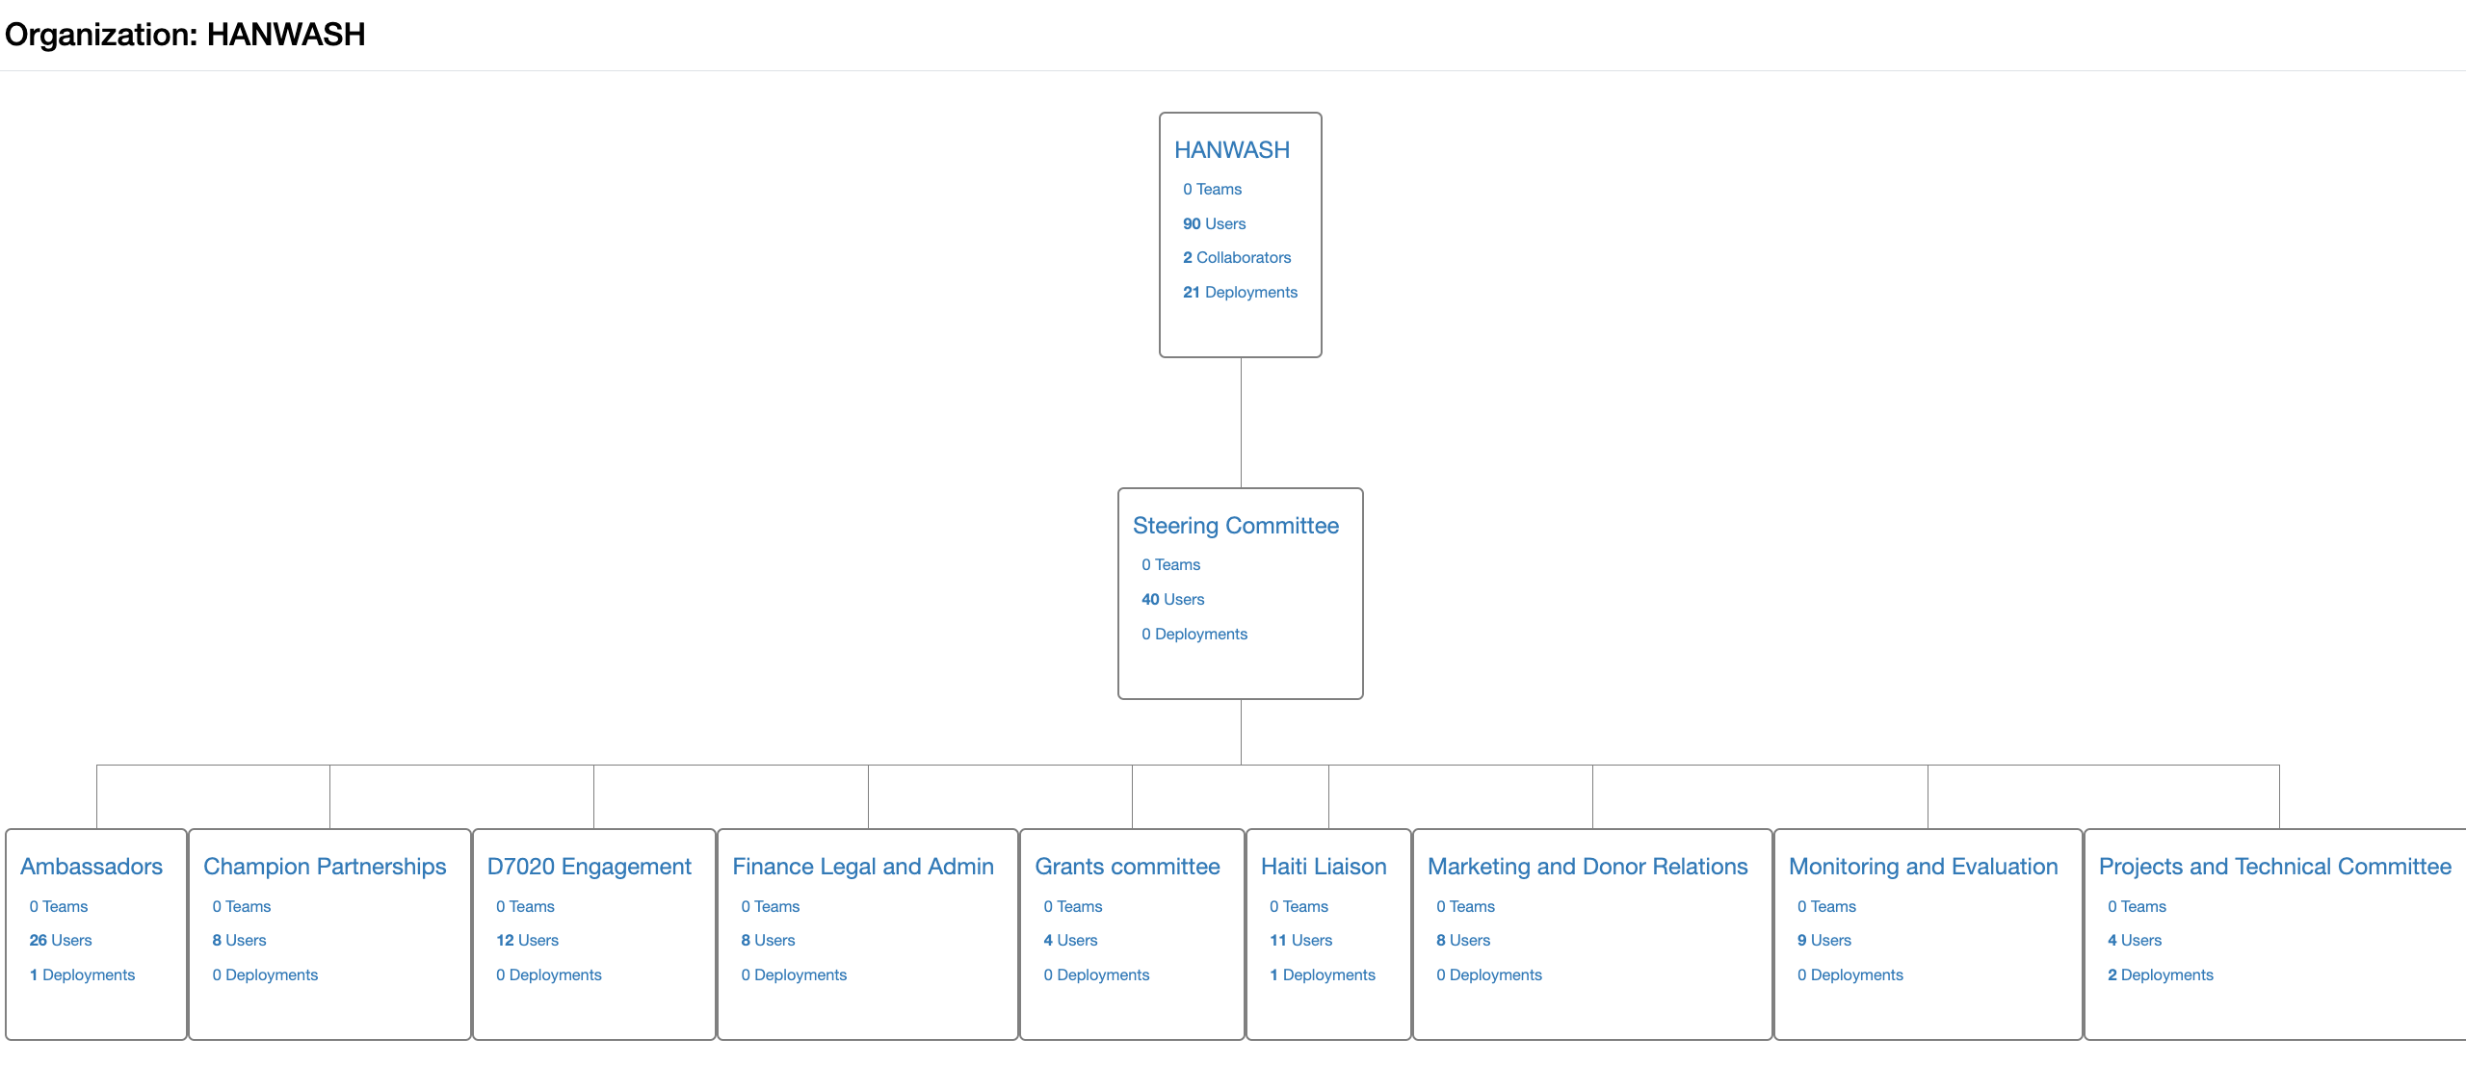
Adding a user to the organization
If there is an existing group, to which the user should be added, like Implementing partners, then please add them to that group
Steps
Go to the Organizations page
Select “HANWASH”
Identify the correct branch and add the user to the group as:
Admin
Viewer
Team member (can have many different teams in each branch)

Slide 42
Adding a user to the organization
Note: DO NOT add individual users to the permissions of Surveys, Deployments, and Visualizations, this should be handled via referring to roles within the organization e.g., HANWASH > Steering Committee > Admins
If there is no existing group, first identify the data needs of the user:
Surveys
Should they be able to edit the survey design/schema? Yes, then Admin
Should they be able to deploy the survey to their team? Yes, then Manager
Should they be able to see the survey form’s schema? Yes, then Viewer
Deployments
Should they be able to collect data? Yes, then Enumerator
Should they be able to see the collected data? Yes, then Viewers
Should they be able to edit the collected data at any stage? Yes, then Managers
Should they be able to approve, or reject survey responses? Yes, then Approvers
Visualizations
Should they be able to edit the console structure? Yes, then Admins
Should they be able to view the console? Yes, then Viewers
Should they be able to view the console without logging in? Yes, then Sharelink
Organization
Should they be able to add other users and modify all HANWASH’s data? Yes, then Admins
Should they be added automatically as managers to HANWASH surveys? Yes, then Managers
Should they be able to see HANWASH data? Yes, the Viewers

Slide 43
Train Implementing Partners on collecting and approving data
Use the training manual for implementing partners:
HANWASH – Implementation tracking training_ht.pptx
HANWASH – Implementation tracking training_fr.pptx
HANWASH – Implementation tracking training_en.pptx

Slide 44
Water access projections
Commune | Water access |  | Population
 | % of people with basic access | % of people with safely managed | Total | # of people with at least basic access | # of people with safely managed
Pignon | 67% | 0% | 43,263 | 28,986 | 0
Cavaillon | 55% | 0% | 48,687 | 26,778 | 0
Terre Neuve | 27% | 0% | 31,252 | 8,438 | 0
Leogane | 71% | 0% | 199,813 | 141,867 | 0
Ferrier | 98% | 0% | 14,642 | 14,349 | 0
Total | Start (2023) | # | 337,657 | 220,418 | 0
 |  | % | - | 65% | 0%
 | Added | # | - | 100,000 | 27,500
 |  | % | - | 30% | 8%
 | End (2028) | # | 337,657 | 320,418 | 27,500
 |  | % | - | 95% | 8%
Notes: Population data is drawn from IHSI 2015 Water access levels data uses proxy indicators established by DINEPA and measured in 2020: Basic: Households within 500m of a functional and improved water point. Safely managed: Households connected to a water system, which has 24/7 service and treats its distributed water. Safely managed access is included within "at least basic", so they are not addative. Population growth, which is typically <2%, is not taken into account in this analysis.

Slide 45
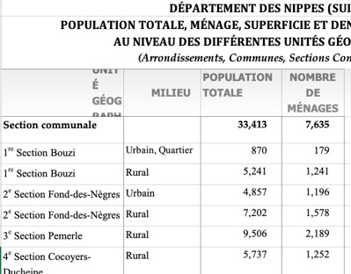
Population data
Resource | “Population totale, population de 18 ans et plus, ménages, et densités estimes en 2015”
Data provider | IHSI (Institut Haïtien de Statistique et d’Informatique)
Format | PDF, XLSX
Aggregation level | Section, Quartier
Update period | Ideally, every 10 years, but it’s been 20 years since the last Census and the 2020 Census is still blocked.
Data collection method | Data is extrapolated from the 2003 Census
Advantages | The official population data for Haiti, published by the government
Disadvantages | Its not geolocalized so it can’t be visualized on a map, unless joined to the CNIGs Admin Regions data Data may be innacurate due to age

Slide 46
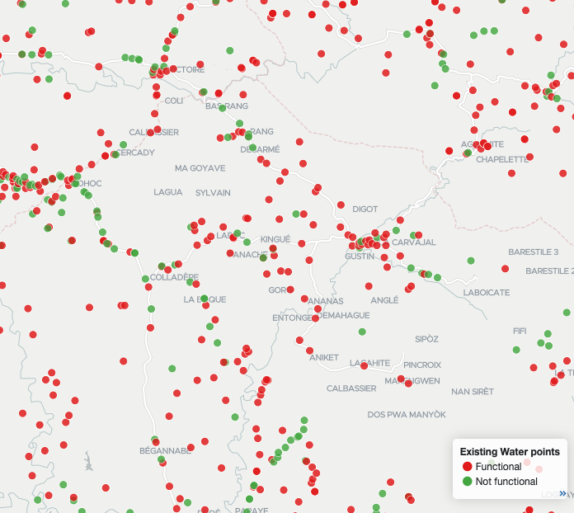
Water point Data
Resource | Inventaire des Points d’Eau
Data supplier | DINEPA (SIEPA.mwater.co > Thematique > Eau Potable)
Format | mWater, Shapefile, and Excel
Aggregation level | Commnal section, commune, department, national
Update frequency | DINEPA set the goal of updating these every year, but it hasn’t been updated since 2017 (full) and 2021 (partial)*
Sample | -100% sampling of water point
Data collection | -Collected in the field by TEPACs
Advantages | -Exhaustive -Provides information on a sub-communal section level -Can be used for planning, project design, and monitoring
Disadvantages | -Only allows for a PROXY of JMP basic water service
Notes | -Includes only improved and unimproved water points but not surface water. -Includes only publicly accessible water points, so it does not includes self-supply or institutional access i.e. those who don’t provide water to the community at large.
*HANWASH Supported the 2021 data update through fundin from ONEPA

Slide 47
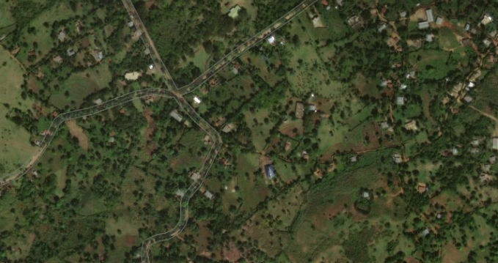
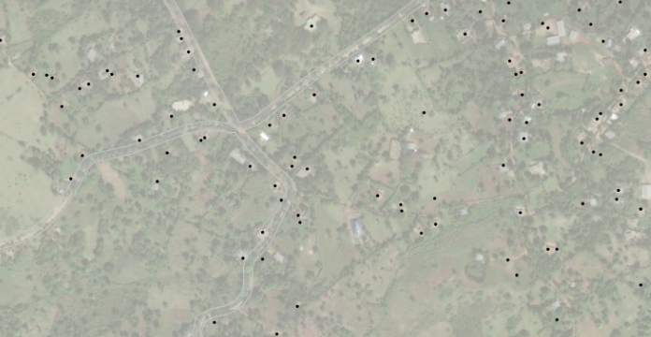
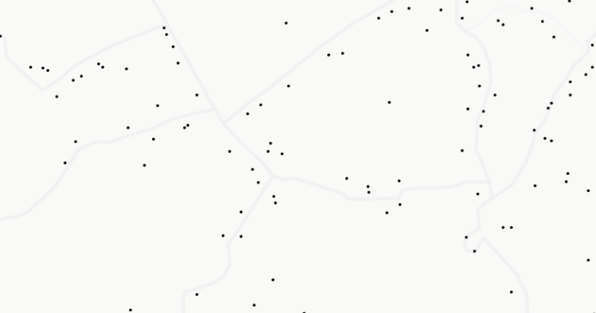
CNIGS “Building” data
Imagery
Resource | "Bâtiments" or "Building" data layer
Data supplier | Centre National d’Information GeoSpatielle (CNIGS)
Format | mWater, Shapefile, Web Tile Service (can be added as mWater Tile layers)
Aggregation level | Commnal section, commune, department, national
Update frequency | - 2012 was the last update - CNIGS set the goal to update this in 2015, but this was never completed and there is currently no plan to update.
Sample | -100% sampling of "Buildings"
Data collection | - Digitized manually from satellite imagery
Advantages | - Exhaustive (~2.3 million buildings) - Provides visualization on the sub-communal section level
Disadvantages | - "Buildings" isn’t exactly equal to "Households". There are also places where buildings were incorrectly registered e.g. some ceimaries or markets. This produces a level of innacuracy that is difficult to quantify, but has been estimated at a 15% overcount. But, assuming that the error is evenly distributed spatially, the percentage access should be the same for "Building" as "Households".
Notes | Buildings is used interchangably with "Housholds" and "Population" when used to visualize access. There is a significant error in this dataset, but it is ok for an estimate to get% access, while not giving an accurate population count.
Opportunity | Migrate to using the High Resolution Settlement Layer (Link here), which uses a different set of underlying datasources from 3rd parties [outside of Haiti].
Imagery + Buildings
Legend
Buildings
Building

Slide 48
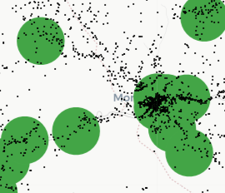
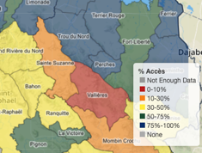
Access calculation
Buildings without access
Buildings with access
Resource | DINEPA Basic Water Access
Data supplier | DINEPA
Format | mWater, Shapefile, and Excel
Aggregation | Communal section, commune, department, national
Update | -Updated in 2017. Must be manually calculated by DINEPA via QGIS
Sample | -100% sampling of water point -100% sampling of buildings
Data calculation | -Access is calculated as "Buildings within 500m (Euclidian/Planar distance) from a Functional & Improved water point " This calculates a "% of buildings with access". -The % of buildings is then multiplied by the IHSI population to get the raw number of people with(out) access.
Advantages | -Permits for visualization and mapping -Provides information on a sub-communal section level -Rapid calculation of access accross the whole country
Disadvantages | This is only a PROXY indicator for JMP Basic Service
Assumptions | Does not take into account natural or manmade barriers to walking e.g. crossing rivers,
Opportunities | This is an opportunity for HANWASH to fund sector monitoring through the automatic calculation of this data to reflect partner investments [talk to Annie Feighery, CEO mWater]
Legend
Building
500m access*
*There is a functional and improved water point at the center of each 500m access circle
Access levels aggregated to the commune

Slide 49


Projects, Activities, and commune action plans
# of implemented activities in alignment
100 x
% of implemented activities in alignment with Commune Action Plans =
# of activities implemented
Activities table
ID | Name | Project | Commune Action Plan
112 | Belmè 2 | HANWASH > Cavaillon 3 | Cavaillon
113 | Lacoste | HANWASH > Cavaillon 3 | Cavaillon
114 | Wo Dirak | HANWASH > Cavaillon 3 | Cavaillon
115 | Ba Dirak | HANWASH > Cavaillon 3 | None
116 | Haut Mariani | None | Cavaillon
…
3
100 x
= 75%
Indicator value =
4

Slide 50
Implementation monitoring
 |  |  | Dashboard
 |  | Complete | Summary | Site | Adopt-a-well | Indicators | QA
User group | HANWASH professional team |  | x | x | x | x | x
 | HANWASH Board of Directors |  | x |  |  | x
 | Rotary Ambassadors |  | x | x | x | x
 | Haiti Liaison | x | x | x | x | x
 | DINEPA |  | x | x |  | x
 | Local authorities |  | x | x |  | x
 | Implementing partners |  | x | x | x | x | x
 | Funders | x | x |  | x

Slide 51
Dashboards for each user group
 |  |  | Dashboard
 |  | Complete | Program summary | Project details | Activity details | Commune action planning | Fundraising tools | Validation results
User group | HANWASH professional team | x | x | x | x | x | x | x
 | HANWASH Board of Directors |  | x |  |  |  | x
 | Rotary Ambassadors |  | x | x | x | x
 | Haiti Liaison | x |  | x | x |  | x
 | DINEPA |  | x | x |  | x |  | x
 | Local authorities |  | x |  |  | x
 | Implementing partners |  |  | x | x | x |  | x
 | Funders | x | x |  |  |  | x

